Slide 1
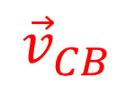
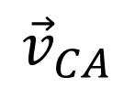
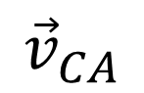
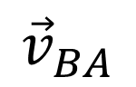
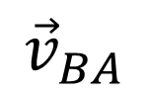
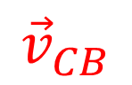
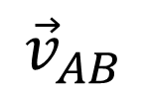
C
Velocity vector relation
C
$${\vec{v}}_{BA}$$
$${\vec{v}}_{CB}$$
$${\vec{v}}_{CA}$$
$${\vec{v}}_{CA}$$
$${\vec{v}}_{CB}$$
Drawn in the frame of A
Drawn in the frame of B
$${\vec{v}}_{BA}$$
$${\vec{v}}_{AB}$$
A
B
A
B

Slide 2

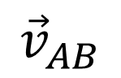
C
Drawn in the frame of B
$${\vec{v}}_{CB}$$
$${\vec{v}}_{AB}$$
A
B

Slide 3
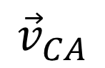
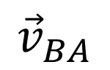
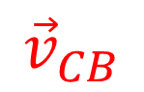
$${\vec{v}}_{BA}$$
$${\vec{v}}_{CB}$$
$${\vec{v}}_{CA}$$

Slide 4
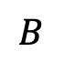
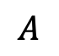
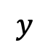
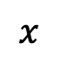
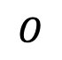
$$y$$
$$A$$
$$x$$
$$O$$
$$B$$

Slide 5
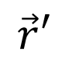
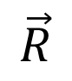
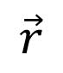
y
y’
S
S’
V
P
X=Vt
(x,y,z)
$$\vec{r}$$
(x’,y’,z’)
$$\vec{r}′$$
$$\vec{R}$$
x, x’
O
O'
z
z'

Slide 6
y
y’
V
S
S’
Source at rest at origin in S’
x, x’
O
O'

Slide 7
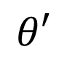
y
y’
Source at rest in S’
V
S
S’
$$θ′$$
x, x’
O
O'

Slide 8
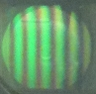
M₂
“Ether”
M
A
Compensator
O’
B
O
C
M₁
Extended Source
E
Telescope

Slide 9
Discharge tube
2θ
Backward emission
θ
f₂
Forward
emission
f₁
To spectrograph

Slide 10
Light
Quartz window
electrons
E
C
G
Variable Power Supply, V

Slide 11
Quartz window
E
C
Light
G
Variable Power Supply, V

Slide 12
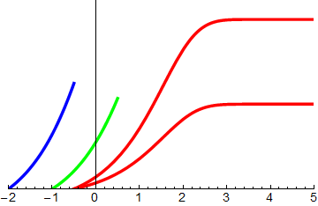
photo-electric-effect-plot
I₂ = 2I₁, λ₁
Photocurrent
λ₃
λ₂
I₁ , λ₁
V
Stopping potential for λ₁
Stopping potential for λ₂
Stopping potential for λ₃

Slide 13
i
2 I
V₀
I
0
V
Impeding voltage
Accelerating voltage
V_{C} – V_{E} < 0
V_{C} – V_{E} > 0

Slide 14
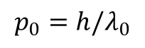
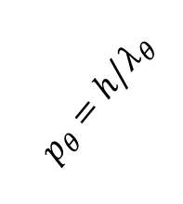
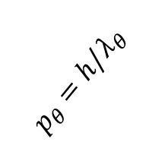
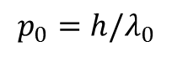
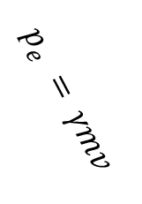
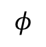
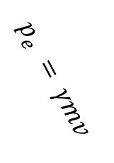
Scattered photon
(a) Before collision
(b) After collision
$p_{θ}=h/λ_{θ}$
$$p_{0}=h/λ_{0}$$
θ
Incoming photon
Electron at rest
$$φ$$
$$p_{e }^{}= γmv$$
Recoiled electron
(c) Triangle of momentum vectors
$p_{θ}=h/λ_{θ}$
$$p_{e }^{}= γmv$$
θ
$$p_{0}=h/λ_{0}$$

Slide 15
Lead
Calcite crystal
θ
Carbon Target
Ionization chamber
X-ray tube

Slide 16
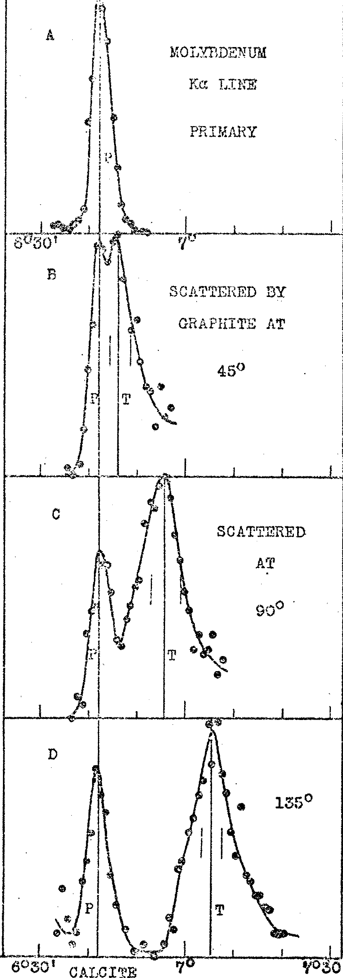

Slide 18
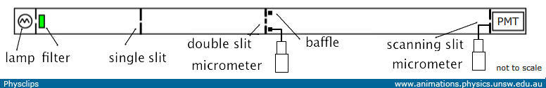
PMT
Double slit
Slit blocker micrometer
Lamp
Filter
Single slit
Detector slit micrometer

Slide 19
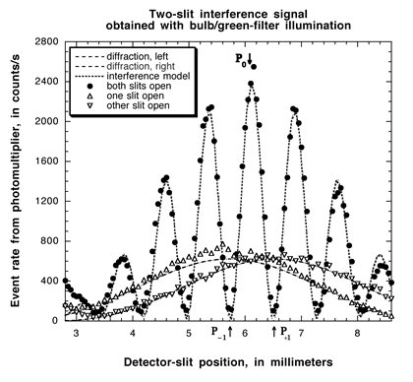

Slide 22
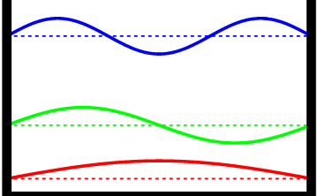
n = 3
E₃ = 9 E₁
n = 2
E₂ = 4 E₁
n = 1
E₁

Slide 23
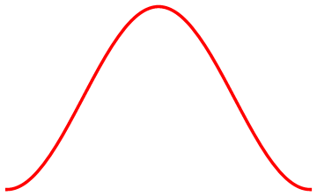
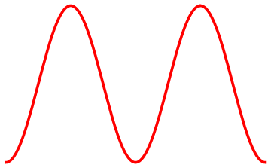
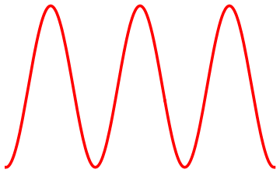
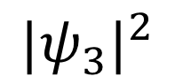
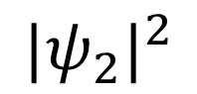
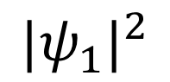
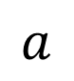
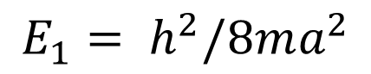
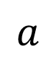
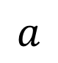
n = 1
n = 2
n = 3
$$E_{1}= h^{2}/8ma^{2}$$
E₂ = 4 E₁
E₃ = 9 E₁
$${|ψ}_{1}|^{2}$$
$${|ψ}_{2}|^{2}$$
$${|ψ}_{3}|^{2}$$
$$a$$
$$a$$
$$a$$

Slide 24
incident
transmitted
E
U(x)
Classical
U₀
x
O

Slide 25
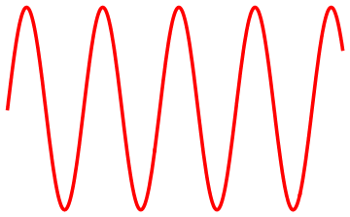
reflected
transmitted
incident
E
U(x)
Quantum
U₀
x
O

Slide 26
U(x)
Classical
U₀
Classical Particle
reflected
No particle
incident
E
x
O
a

Slide 27
U(x)
I
II
III
reflected
U₀
Quantum
transmitted
evanescent wave
E
E
incident
x
O
a

Slide 28
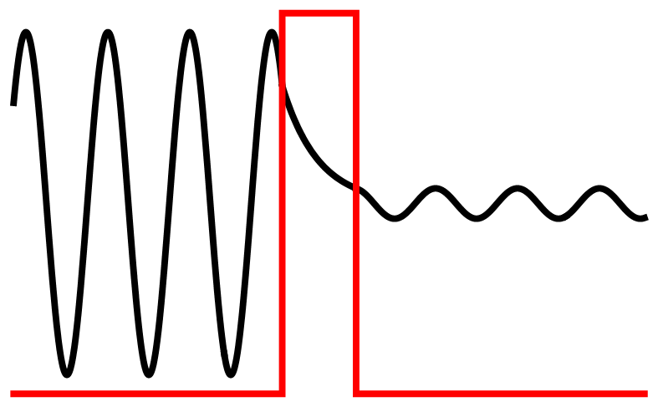
U₀
E

Slide 29
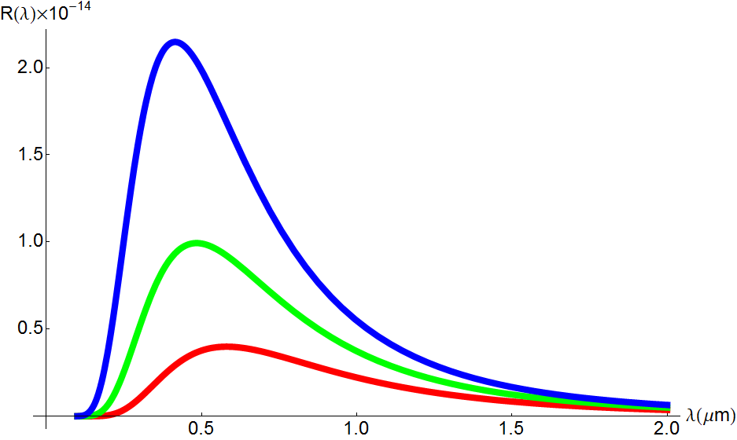
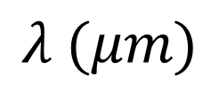
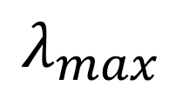
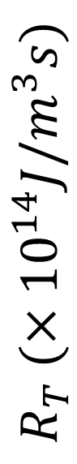
$$λ_{max}$$
T=7000K
$$R_{T} (×{10}^{14}J/m^{3}s)$$
T=6000K
T=5000K
Visible range
$$λ (μm)$$

Slide 30
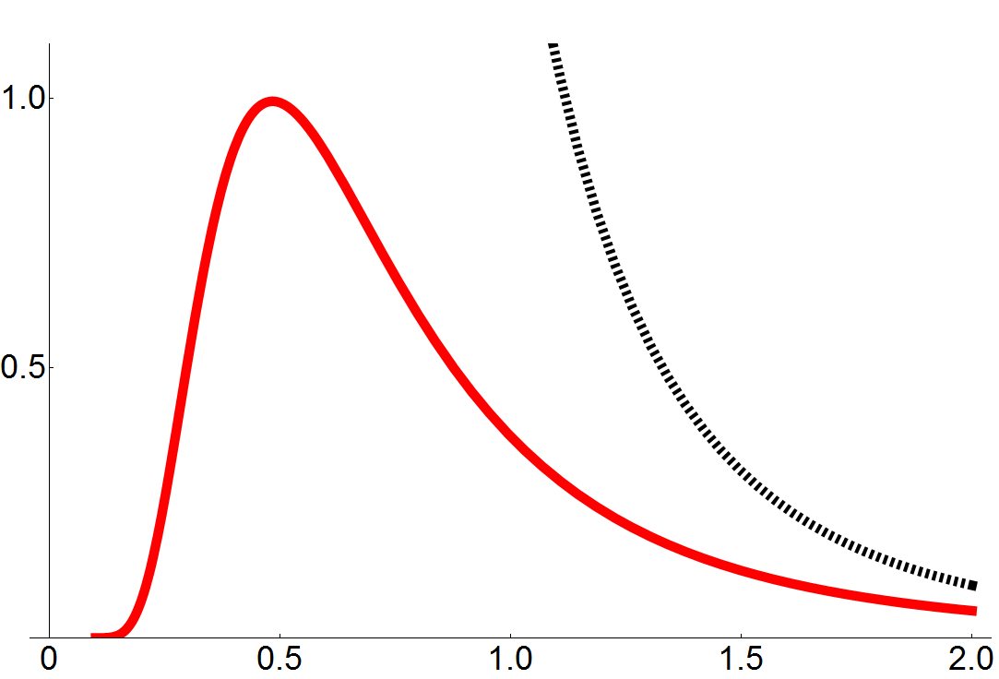


Raleigh-Jeans Law
$$R_{T} (×{10}^{14}J/m^{3}s)$$
Experiment,
T = 6000K
$$λ (μm)$$

Slide 31

Global Warming Art by Robert A. Rohde, creative commons.

Slide 32

Tunneling current amplifier
Piezo-electric scanner
Scanning and Feedback control
$$I_{t}$$
Bias voltage
Data Processing and display

Slide 33
Work function
Vacuum
ᶲ
ᶲ
Tunneling
eV_{bias}
Tip
Sample

Slide 35
Circular diffraction rings
Incident Beam
[X-rays or electrons]
Thin gold foil
Photographic plate

Slide 36


Movable
Detector
Nickel
Target
Electron
source
$$θ$$
Electron beam
Accelerating voltage

Slide 37
54 eV electron
65 eV electron
50⁰
44⁰

Slide 38
ᶲ
90⁰-θ
ᶲ
θ
D
A
θ
d
C
a
B
d
[AB+BC] – AD = d sin θ

Slide 39
Electron beam
Thin gold foil
Photographic plate
Diffraction pattern on the
photographic plate

Slide 40

Field emission tip
Ring anodes
10 V
3 kV
Electron
Optics
“Double slit”
Electron
Focusing and Detection
50 kV
Display

Slide 41
E = 0
E₄ = - 0.8 eV
4s
4p
4d
4f
E₃ = - 1.5 eV
3s
3p
3d
E₂ = - 3.4 eV
2s
2p
E₁ = - 13.6 eV
1s

Slide 42




E = 0
E₄ = - 0.8 eV
4s
4p
4d
4f
E₃ = - 1.5 eV
3s
3p
3d
E₂ = - 3.4 eV
$$∆E=−3.4−\left(−1.5\right)=−1.9 eV$$
2s
2p
$$f=\frac{∆E}{h}=4.59×{10}^{14}Hz$$
(Visible light)
$$∆E=−13.6 −\left(−3.4\right)=−10.2 eV$$
$f=\frac{∆E}{h}= \frac{10.2 eV }{4.14×{10}^{−15}eV.s}=2.46$ $×{10}^{15}Hz$
(UV light)
E₁ = - 13.6 eV
1s

Slide 43
L
v
I
e
μ

Slide 44






















z
z
$$+2ℏ$$
$$+2ℏ$$
$$\sqrt{6}ℏ$$
$$\sqrt{6}ℏ$$
$$+1ℏ$$
$$+1ℏ$$
$${35}^{0}$$
$$\sqrt{6}ℏ$$
$${35}^{0}$$
$${66}^{0}$$
$$\sqrt{6}ℏ$$
$${66}^{0}$$
$$\sqrt{6}ℏ$$
$$\sqrt{6}ℏ$$
$$0$$
$$0$$
$$\sqrt{6}ℏ$$
$$\sqrt{6}ℏ$$
$$−1ℏ$$
$$−1ℏ$$
$$\sqrt{6}ℏ$$
$$\sqrt{6}ℏ$$
$$−2ℏ$$
$$−2ℏ$$

Slide 45







z
$$+\frac{1}{2}ℏ$$
$$\vec{S}$$
$${54.7}^{0}$$
$$\frac{\sqrt{3}}{2}ℏ$$
$$0$$
$$\frac{\sqrt{3}}{2}ℏ$$
$$−\frac{1}{2}ℏ$$
$$\vec{S}$$

Slide 46


$B=0$
$B ≠0$
m_{l} = -1, 0, 1
m_{l} = 1
n=2, l = 1
m_{l} = 0
m_{l} = -1
ΔE =hf₀
ΔE =hf₀
ΔE =
h(f₀ -f_{B} )
ΔE =
h(f₀ +f_{B} )
n=1, l =0
m_{l} = 0
m_{l} = 0
f₀
f₀ - f_{B}
f₀
f₀ + f_{B}
Emission spectrum with no magnetic field
Emission spectrum when there is a magnetic field

Slide 47
$B=0$
$B ≠0$
m_{l} = 1, m_{s} =+1/2
m_{l} = -1, 0, 1
m_{l} = 0, m_{s} =+1/2
n=2, l = 1
{m_{l} = -1, m_{s} =1/2}, {m_{l} = +1, m_{s} = -1/2}
m_{l} = 0, m_{s} =-1/2
m_{l} = -1, m_{s} =-1/2
ΔE =hf₀
ΔE =hf₀
ΔE =
h(f₀ -f_{B} )
ΔE =
h(f₀ +f_{B} )
n=1, l =0
m_{l} = 0
m_{l} = 0
f₀
f₀ -2f_{B}
f₀ -f_{B}
f₀
f₀ +f_{B}
f₀ +2f_{B}
Emission spectrum with no magnetic field
Emission spectrum when there is a magnetic field

Slide 48
d
θ
v₀
E
w

Slide 49
θ
v₀
E
B
w

Slide 50
V_{d}
θ
E
v=0
v
v
h
d
V=0
V_{acc}
w

Slide 51

1.52 eV
4.2 eV
0.24 nm

Slide 52




$$Repulsive core= +\frac{A}{r^{10}}$$
Net potential
energy
$$r=r_{0}$$
Cohesive
energy
$$Electrostatic potential= −\frac{1}{r}$$

Slide 53
-2δ
+δ
+δ
Hydrogen Bond
-2δ
+δ
+δ

Slide 54
Na⁺
Cl⁻

Slide 55
X-rays
Crystal
Photographic plate

Slide 57
ᶲ
90⁰-θ
ᶲ
θ
D
A
θ
d
C
a
B
d
[AB+BC] – AD = 2d sin θ

Slide 58
a
a
d₁
d₂

Slide 59

Empty
Conduction Band
Partially Filled
Conduction Band
Electrons
$$E_{g}$$
Holes
Completely Filled
Valence Band
Partially Filled
Valence Band
(a) T = 0 K
(a) T > 0 K

Slide 60


(b)
(a)

Slide 61
Si
Si
Si
Si
Si
Si
Si
Si
Si
Si
Si
Si
Si
Si
Si
Si
Si
Si
Si
Si
Si
Si
Si
Si
Si
Si
Si
Si
Si
Si
Si
Si
Si
Si
Si
Si
Si
Si
Si
Si
Si
Si
Si
Si
Si
Si
Si
Si

Slide 62
Si
Si
Si
Si
Si
Si
Si
Si
Si
Si
Si
Si
Si
Si
As
Si
Si
Si
Si
As
Si
Si
Si
Si
Si
Si
Si
Si
Si
Si
Si
Si
Si
Si
Si
Si
Si
As
Si
Si
Si
Si
Si
Si
Si
Si
Si
Si
(a)

Slide 63


Conduction Band
$$E_{d}$$
Donor Levels
$$E_{g}$$
Valence Band
(b)

Slide 64
Si
Si
Si
Si
Si
Si
Si
Si
Si
Si
Si
Si
Si
Si
Al
Si
Si
Si
Si
Al
Si
Si
Si
Si
A
B
C
Si
Si
Si
Si
Si
Si
Si
Si
Si
Si
Si
Si
Si
Al
Si
Si
Si
Si
Si
Si
Si
Si
Si
Si
(a)

Slide 65

Conduction Band
$$E_{g}$$
Acceptor Levels
$$E_{a}$$
Valence Band
(b)

Slide 66
Si
Si
Si
Si
Si
Si
Si
Si
Si
Si
Si
Si
Si
Si
Si
Si
Si
Si
Si
Si
Si
Si
Si
Si
Si
Si
Si
Si
Si
Si
Si
Si
Si
Si
Si
Si
Si
Si
Si
Si
Si
Si
Si
Si
Si
Si
Si
Si

Slide 67
+4
+3
+4
+4
+4
+4
+5
Al
Si
+4
+4
+4
As
+4
+4
+4
+4
+4
+4
+4
+4
+4
+4
+5
+4
+4
+3
+4
+4
+4
+4
+4
+4
+4

Slide 68






Depletion region
(a)
p
n
$$E$$
Holes
Electrons
Fixed ion cores
$$E_{x}$$
+
x
(b)
-
$$V$$
(c)
$$V_{i}$$
x

Slide 69

Reverse bias
Forward bias
p
n
p
n
A
A
p
n
p
n
Depletion region
Depletion region
Forward bias
Reverse bias

Slide 70






p
Energy
n
$$E_{c,p}$$
$$E_{c,n}$$
$$E_{F}$$
$$E_{v,p}$$
x
photon
$$E_{v,n}$$

Slide 71
p--type
Active Region
n--type
Conduction band
Electron barrier
Electron injection
photon
Hole injection
Hole barrier
Valence band

Slide 72


$$N=Z$$

Slide 73




Photographic plate
$$γ$$
$$β^{+}$$
$$β^{−}$$
B
$$α$$
Radioactive material
Lead block

Slide 74

Relative number of electrons
K_{max}
Kinetic energy (MeV)

Slide 75


⁴⁰K
Electron Capture;
Q = 1.502 MeV
⁴⁰Ar*
Gamma Decay;
ΔE = 1.46 MeV
$$γ$$
⁴⁰Ar

Slide 76

N
145
140
135
130
125
120
Z
80
85
90

Slide 77

Yield
A

Slide 78

Yield(%)
7
1
0.1
0.01
$A\sim 1$18
0.001
A
80
100
120
140

Slide 79
235
U
92
90
Sr
90
Sr
235
38
n
n
U
38
92
n
n
143
Xe
143
235
U
54
235
U
Xe
92
54
94
Kr
n
92
94
Kr
94
Kr
n
36
36
36
n
235
U
235
U
235
U
92
n
n
92
n
92
n
139
Ba
139
Ba
56
235
n
56
n
U
94
139
Ba
n
235
92
Kr
U
94
36
56
92
Kr
36
n
139
Ba
139
Ba
n
56
n
56
235
U
n
92
n
n
235
U
92

Slide 80

http://www.freeinfosociety.com/site.php?postnum=3115

Slide 81











$$π^{−}$$
$$π^{−}$$
$$π^{−}$$
$$π^{+}$$
$$π^{+}$$
$$π^{+}$$
$$π^{−}$$
$$π^{+}$$
$$\overline{p}$$
$$μ^{+}$$

Slide 82










$$e^{−}$$
$$e^{−}$$
$$p$$
$$e^{−}$$
$$γ$$
$$γ$$
Interaction vertex
$$e^{−}$$
$$p$$
$$e^{−}$$
$$e^{−}$$
(a)
(b)
(a)

Slide 83




Baryons
Mesons
p
$$π^{+}$$
u
u
u
$$\overline{d}$$
d
n
$$π^{−}$$
d
d
d
$$\overline{u}$$
u

Slide 84


Slide 85


Slide 86


Slide 87


p
$$π^{+}$$
u
u
u
$$\overline{d}$$
d
Colorless proton
(red, green, blue quarks)
Colorless pi meson
(red-antired quarks)

Slide 88










$$q_{\overline{b}}$$
$$q_{r}$$
$$q_{r}$$
$$q_{g}$$
Color is conserved at the vertex
$$g_{rb}$$
$$g_{g\overline{r}}$$
$$q_{\overline{b}}$$
$$q_{r}$$
$$q_{r}$$
$$q_{g}$$
(a)
(b)

Slide 89
Current
R
V_{out}
ion
Gas
C
electron
Particle

Slide 90

Wikicommons: http://upload.wikimedia.org/wikipedia/commons/2/23/Spread_of_avalanches_in_G-M_tube.jpg

Slide 91

Scintillator
Photocathode

Slide 92


Slide 93





C
C
$$α$$
x
x
$$θ_{A}$$
$$θ_{B}$$
$$θ$$
$$θ$$
A
B
A
B
D_{A}
D/2
D
D
(a) General
(b) Symmetric

Slide 94



C
$$α$$
x
$$θ_{B}$$
$$θ_{A}$$
A
B
D/2
D
(a) General

Slide 95


“Fixed” background
distant stars
S
$$α$$
x
$$θ$$
Earth
in June
d
Sun
Earth in
December

Slide 96


Slide 97


Slide 98


Slide 99


Slide 100
Period = 5.4 days
3.5
3.8
Magnitude
4.1
4.4
0
1
2
3
4
5
6
Days
Delta Cephei from http://www.eso.org/

Slide 101


Slide 102
410.2
434.1
486.1
656.3
Emitted (nm)
Detected (nm)
410.6
434.5
486.6
657.0

Slide 103

A Precise Distance Indicator: Type IA Supernova Multicolor Light-Curve Shapes
Authors: |  | Riess, Adam G.; Press, William H.; Kirshner, Robert P.
Publication: |  | Astrophysical Journal v.473, p.88 (ApJ Homepage)

Slide 105
Geodesic (straight) path
on curved surface
B
Euclidean straight path
A

Slide 106


Slide 107


Slide 108

http://arxiv.org/pdf/1111.5793v1.pdf; Gravitational effects of the faraway matter on
the rotation curves of spiral galaxies
A. Carati

Slide 109














p
p
→
$${}_{}^{2}H$$
$$e^{−}$$
+
$$ν_{e}^{}$$
p
+
p
→
$${}_{}^{2}H$$
+
$$e^{−}$$
+
$$ν_{e}^{}$$
+
+
p
→
$${}_{}^{3}{He}$$
+
$$γ$$
$${}_{}^{2}H$$
+
p
→
$${}_{}^{3}{He}$$
+
$$γ$$
$${}_{}^{2}H$$
+
$${}_{}^{3}{He}$$
+
$${}_{}^{3}{He}$$
→
$${}_{}^{3}{He}$$
+
p
+
p

Slide 110





$$u$$
$$e^{−}$$
$$W^{−}$$
Interaction vertex
Interaction vertex
$$d$$
$${\overline{ν}}_{e}$$

Slide 111
















$$e^{−}$$
$$ν_{e}$$
$$u$$
$$e^{−}$$
$$e^{−}$$
$$ν_{e}$$
$$ν_{e}$$
$$d$$
(a)
(b)
$$e^{−}$$
$$e^{+}$$
$$e^{−}$$
$$d$$
$$e^{−}$$
$$μ^{+}$$
$$μ^{−}$$
$$d$$
(c)
(d)

Slide 112





$$p$$
$$n$$
$$π^{−}$$
$$n$$
$$p$$

Slide 113


























$$p$$
$$n$$
$$d$$
$$u$$
$$d$$
$$u$$
$$u$$
$$d$$
$$p$$
$$n$$
$$π^{−}$$
$$π^{−}$$
$$d$$
$$g$$
$$g$$
$$\overline{u}$$
$$n$$
$$p$$
$$u$$
$$d$$
$$d$$
$$u$$
$$u$$
$$d$$
$$n$$
$$p$$

Slide 114


Slide 115


Slide 116
Magnetic field
Neutron
Star
To Earth
Beam direction in space

